Slide 1


Intro to Processing
Week 1 - Fundamentals
By Nicole McCabe

Slide 2
What will we Learn?
The Development Environment (IDE)
Functions
Variables
Math
Comments
Conditional Statements (If Else)
Loops (Iteration)
Images
Arrays

Slide 3
The Development Environment

Slide 4
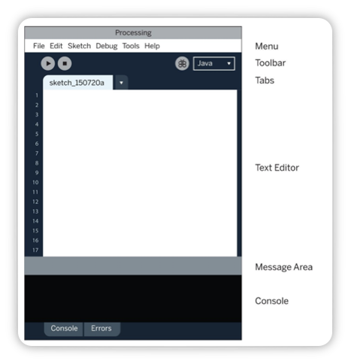
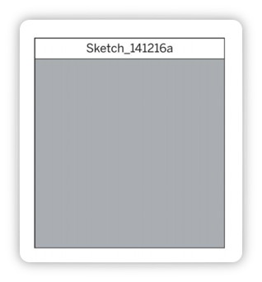
The Development Environment
The window that pops up is called a sketch

Slide 5
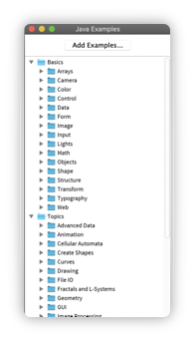
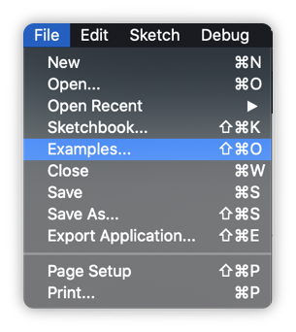
Processing also comes with Examples!

Slide 6
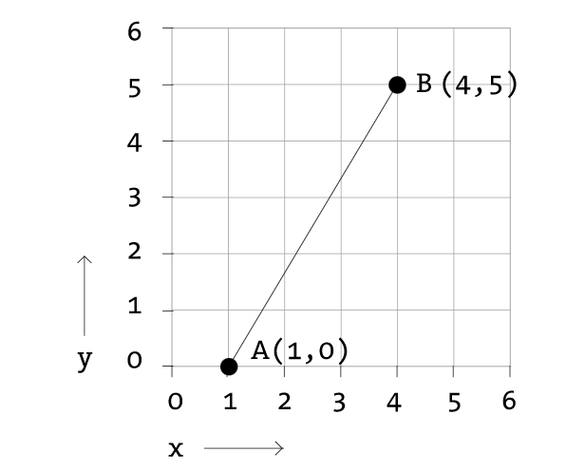
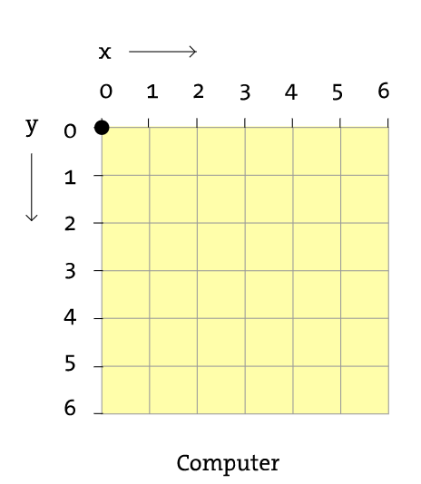
Processing Coordinate System
cartesian coordinates
The computer screen is a grid of light elements called pixels. Each pixel has a position within the grid defined by coordinates.
In Processing, the x coordinate is the distance from the left edge of the Display Window and the y coordinate is the distance from the top edge.
We write coordinates of a pixel like this: (x, y).
So, if the screen is 200×200 pixels, the upper-left is (0, 0), the center is at (100, 100), and the lower-right is (199, 199). Reference
Processing

Slide 7
Functions

Slide 8
What is a Function?
Functions are the basic building blocks for Processing programs.
A computer runs a program one line at a time. But when a function is run, the computer jumps to where the function is defined and runs the code there, then jumps back to where it left off.
The power of functions is modularity. Functions are independent software units that are used to build more complex programs — like LEGO bricks, where each type of brick serves a specific purpose, and making a complex model requires using the different parts together. As with functions, the true power of these bricks is the ability to build many different forms from the same set of elements. The same group of LEGOs that makes a spaceship can be reused to construct a truck, a skyscraper, and many other objects.
Another purpose of functions is reusability. Once a function is defined, the code inside the function need not be repeated again.

Slide 9
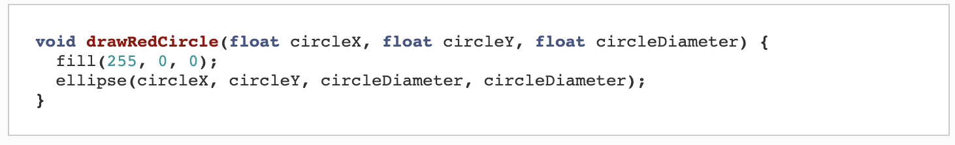
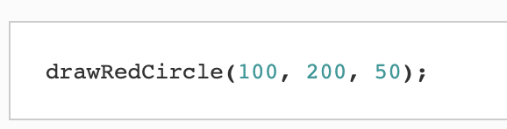
Creating Your Own Function
This function has a void return type (which means it does something instead of giving you a value), and takes three parameters: circleX, circleY, and circleDiameter. The body of the function changes the fill color to red and then uses the parameters to draw a circle.
To create your own function, you need to do four things:
Write the return type of the function (void, int, float etc.)
Write the name of the function.
Inside parenthesis (), list any parameters (input) the function takes.
Inside curly brackets {}, write the code that will run whenever the function is called. This is called the body of the function.
To call this function, you’d use its name and give it parameters, exactly like you’ve been calling other functions:

Slide 10

size() - Change Size of Display Window
To draw a window that is 800 pixels wide and 600 high, type:
size() is an example of a built in function, it is already created in Processing so you don’t have to create it.
The size() function is to set the width and height of the Display Window.
If your program doesn’t have a size() function, the dimension is set to 100×100 pixels.
It has two parameters (input):
the first sets the width of the window
the second sets the height.

Slide 11
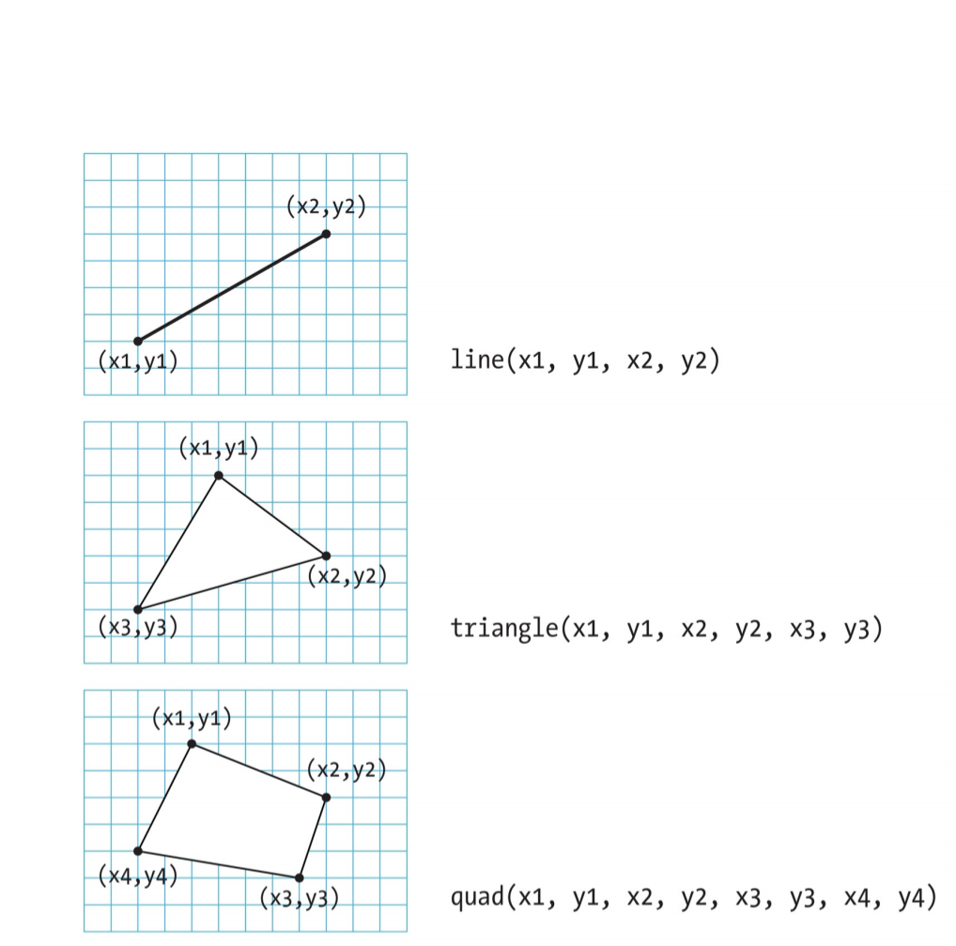
Basics Shapes
Processing includes a group of in built functions to draw basic shapes.
Simple shapes like lines can be combined to create more complex forms like a leaf or a face.
These shapes can also be drawn partially (or entirely) out of the window without an error.

Slide 12
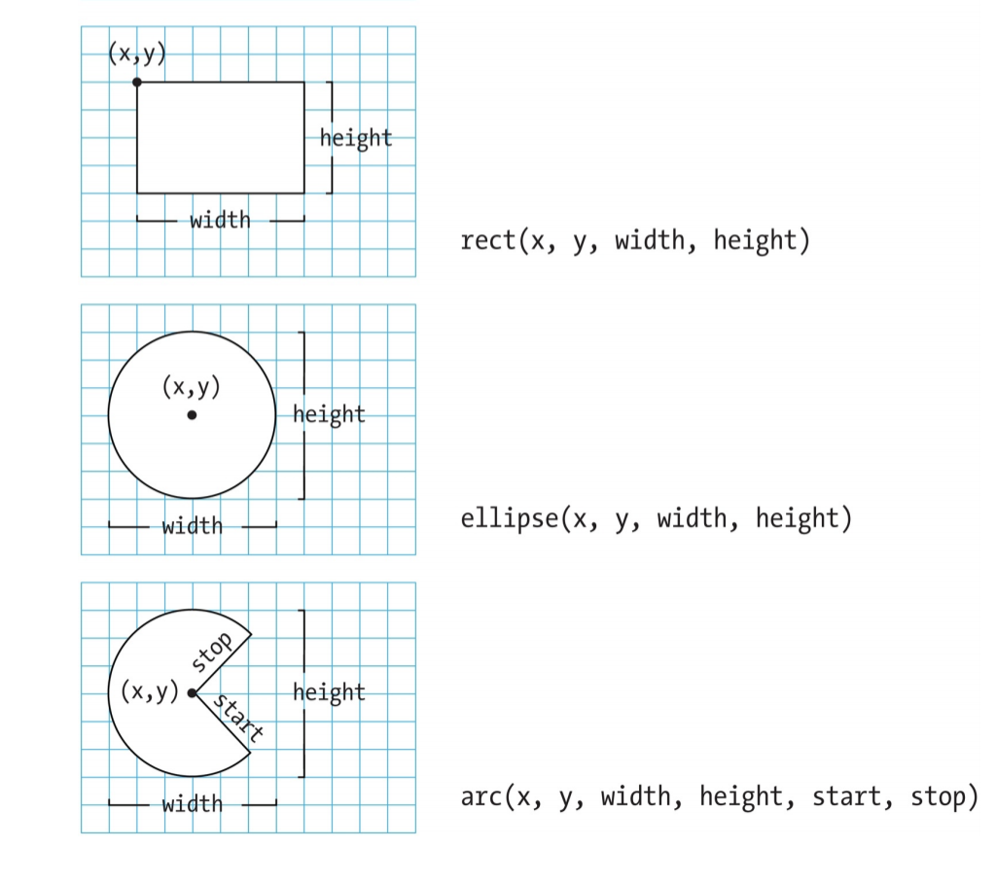
More Basic Shapes
Processing doesn’t have separate functions to make squares and circles. To make these shapes, use the same value for the width and the height parameters to ellipse() and rect().
When a program runs, the computer starts at the top and reads each line of code until it reaches the last line and then stops. If you want a shape to be drawn on top of all other shapes, it needs to follow the others in the code.

Slide 13
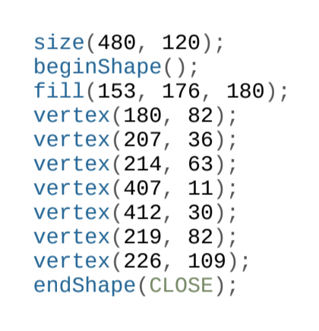
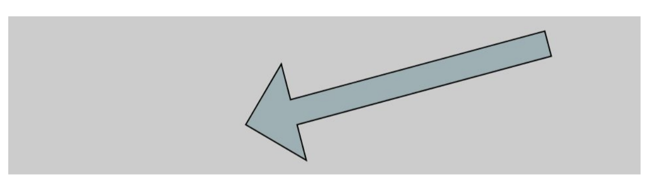
Custom Shapes
You’re not limited to using the previous basic shapes — you can also define new shapes by connecting a series of points.
The beginShape() function signals the start of a new shape.
The vertex() function is used to define each pair of x and y coordinates for the shape.
Finally, endShape() is called to signal that the shape is finished.

Slide 14
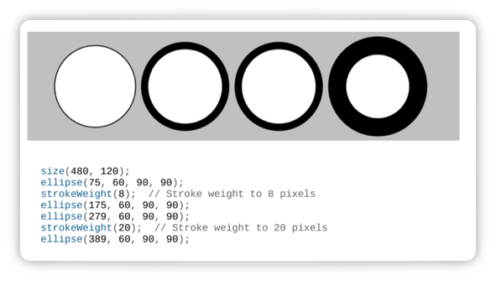
strokeWeight()
The stroke is the outline of the shape.
The default stroke weight is a single pixel, but this can be changed with the strokeWeight() function.
The single parameter to strokeWeight() sets the width of drawn lines.

Slide 15
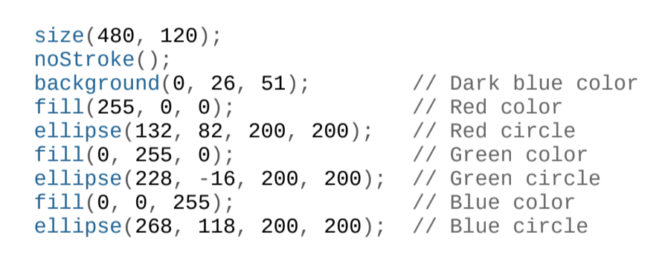

Adding Color: stroke(), fill(), background()
stroke() - Sets the color used to draw lines and borders around shapes.
fill() - Sets the color used to fill shapes
background() - Sets the color used for the background for the Processing window.
The default color space is RGB, with each value in the range from 0 to 255. RGB Reference

Slide 16
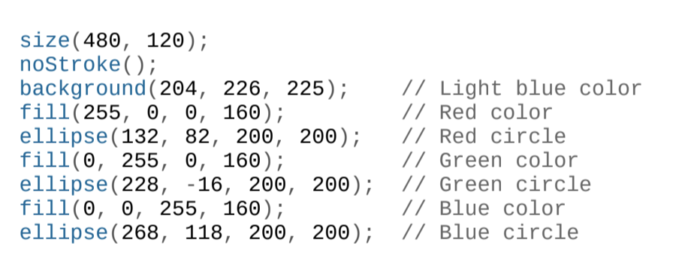

Transparency
By adding an optional fourth parameter to fill() or stroke(), you can control the transparency.
This fourth parameter is known as the alpha value, and also uses the range 0 to 255 to set the amount of transparency.
The value 0 defines the color as entirely transparent (it won’t display), the value 255 is entirely opaque, and the values between these extremes cause the colors to mix on screen

Slide 17
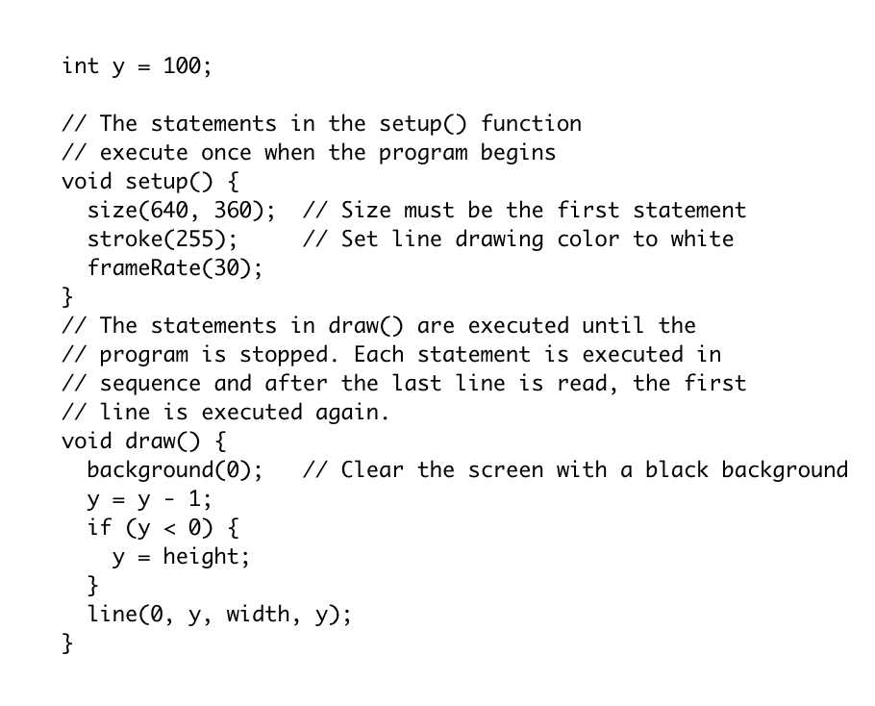
setup() and draw()
The setup() function is run once, when the program starts. It's used to define initial environment properties such as screen size and to load media such as images and fonts as the program starts. There can only be one setup() function for each program and it shouldn't be called again after its initial execution.
Called directly after setup(), the draw() function continuously executes the lines of code contained inside its block until the program is stopped. If you want animation, use the draw() function.

Slide 18
Variables

Slide 19
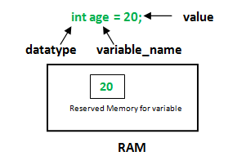
What is a Variable?
A variable stores a value in memory (RAM) so that it can be used later in a program.
The variable can be used many times within a single program, and the value is easily changed while the program is running.
One of the reasons we use variables is to avoid repeating ourselves in the code.
If you are typing the same number more than once, consider using a variable instead so that your code is more general and easier to update.

Slide 20
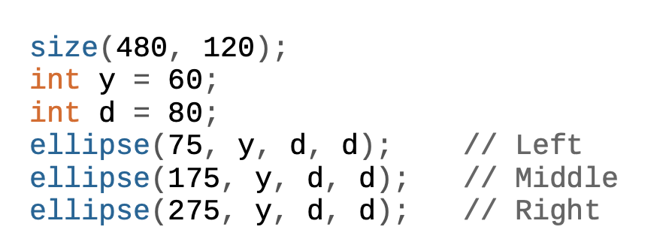
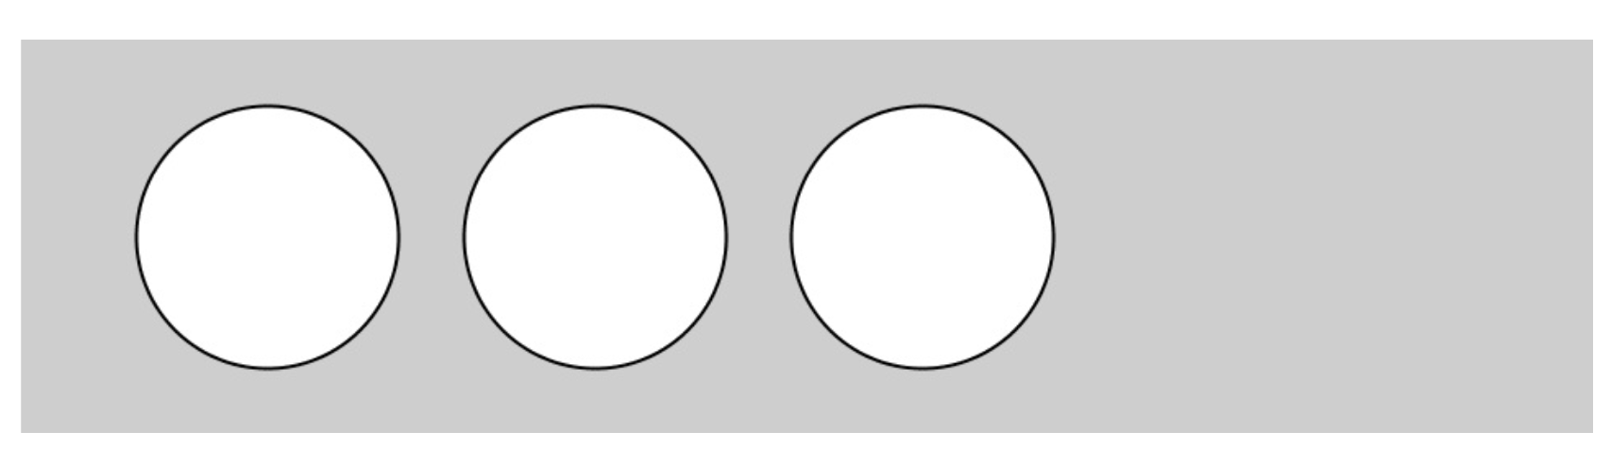
Variable Example
For instance, when you make the y coordinate and diameter for the three circles in this example into variables, the same values are used for each ellipse.
Let’s say that you wanted to change the y coordinate and diameter, without the variables, you’d need to change the y coordinate used in the code three times and the diameter six times.

Slide 21
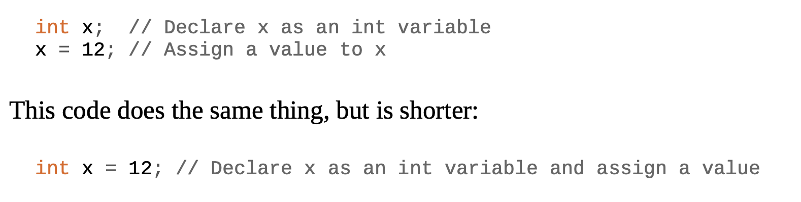
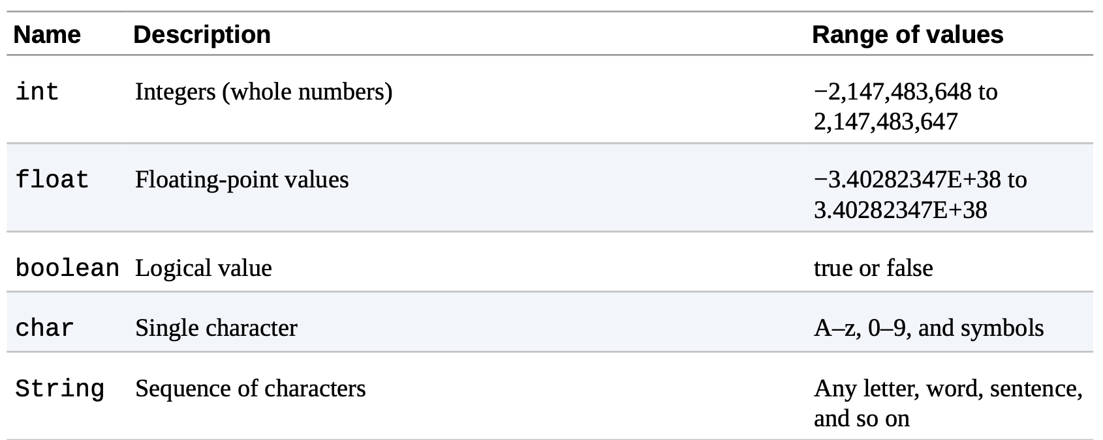
Creating a Variable
When you make your own variables, you determine the name, the data type, and the value. The name is what you decide to call the variable.
The range of values that can be stored within a variable is defined by its data type. For instance, the integer data type can store numbers without decimal places (whole numbers).
After the data type and name are set, a value can be assigned to the variable:

Slide 22
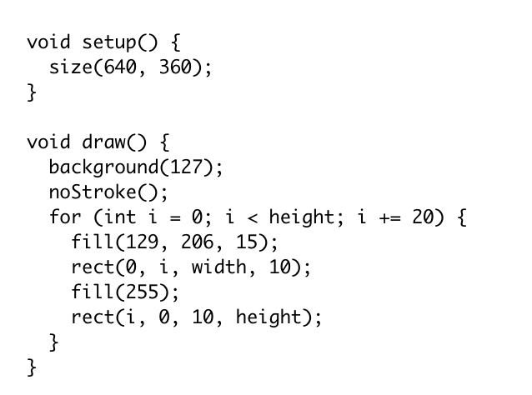
width and height Variables
The width and height of the window is defined by the programmer, in size()
The 'width' and 'height' variables contain the width and height of the display window as defined in the size() function.
These variables are already built into Processing and are examples of built in variables.
Every instance of width is 640 and every instance if height is 350.

Slide 23
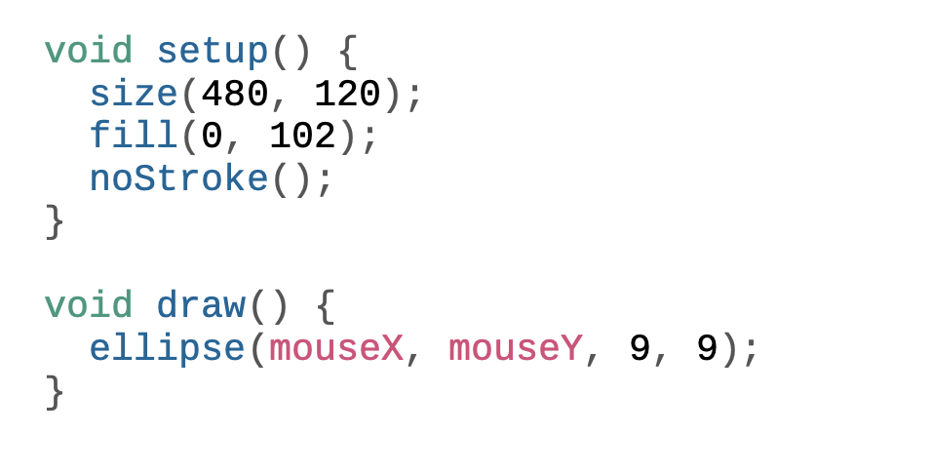
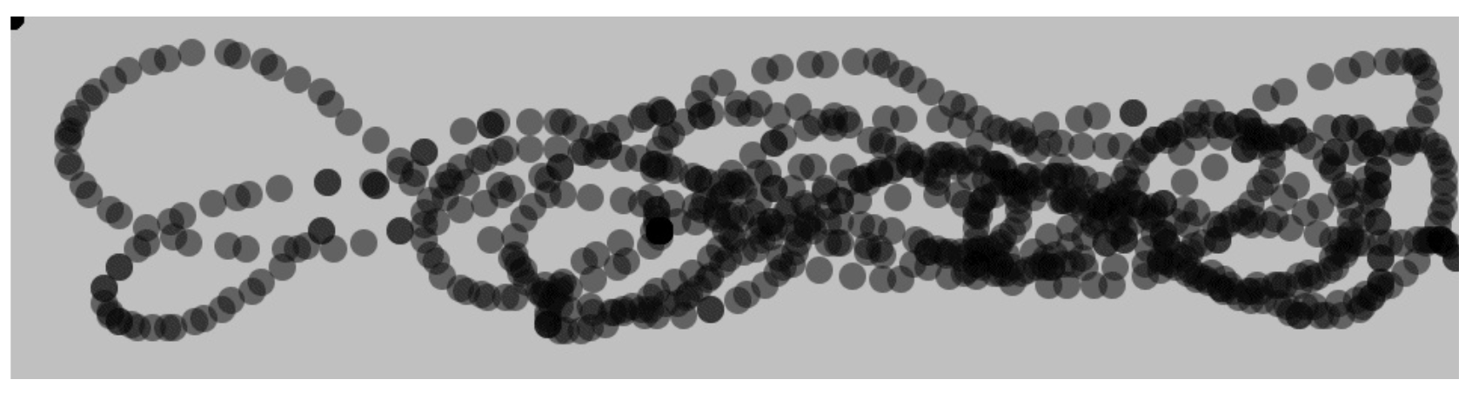
mouseX and mouseY Variables: Track Your Mouse Movements
The mouseX variable stores the x coordinate, and the mouseY variable stores the y coordinate.
These are built in variables that can be used to track the mouse position and use those numbers to move elements on screen.
In this example, each time the code in the draw() block is run, a new circle is drawn to the window. This image was made by moving the mouse around to control the circle’s location.

Slide 24
Math

Slide 25
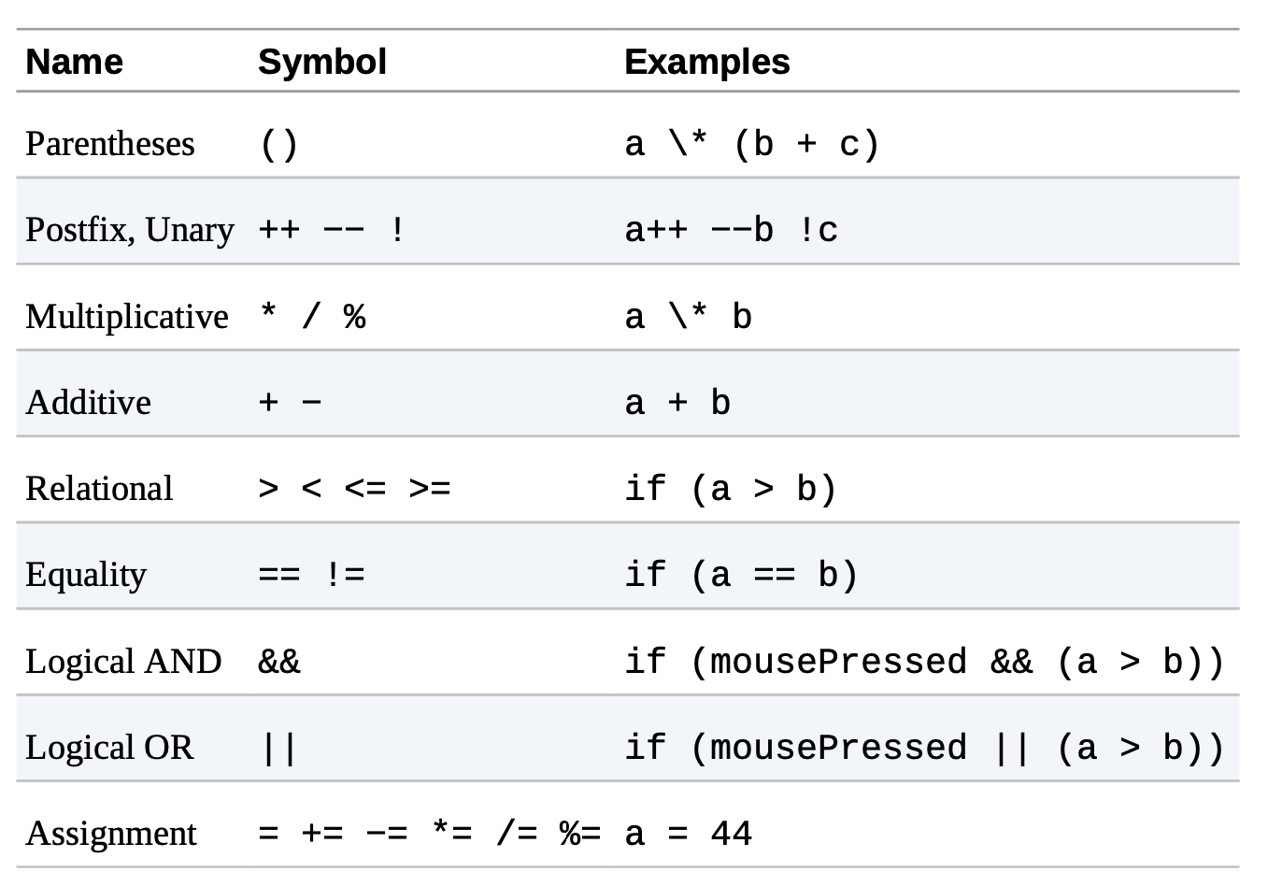
Order of Operations
In the following table, the operators on the top are run before those on the bottom — therefore, an operation inside parentheses will run first and an assignment will run last:
When mathematical calculations are performed in a program, each operation takes place according to a pre-specified order.
This order of operations ensures that the code is run the same way every time.
This is no different from arithmetic or algebra, but programming has other operators that are less familiar.

Slide 26
Comments

Slide 27
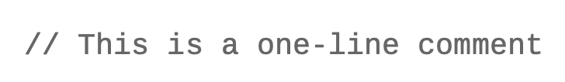
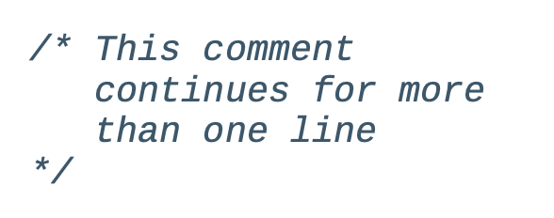
What are Comments?
A comment starts with two forward slashes (//) and continues until the end of the line:
Comments are notes that you write to yourself (or other people) inside the code.
They are ignored when the program is run.
If others are reading your code, comments are especially important to help them understand your thought process.
You can make a multiple-line comment by starting with /* and ending with */. For instance:

Slide 28
Conditional Statements (If Else)

Slide 29
What are Conditional Statements?
Conditions are like questions. They allow a program to decide to take one action if the answer to a question is "true" or to do another action if the answer to the question is "false."
A conditional statement is a set of rules performed if a certain condition is met. It is sometimes referred to as an If-Else statement, because IF a condition is met then an action is performed, ELSE if the condition is false then this action is performed.

Slide 30
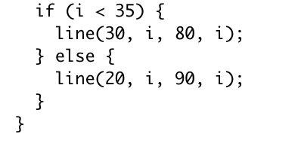
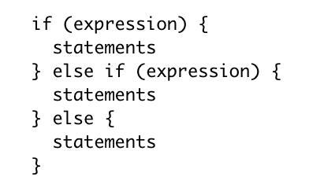
Creating an If Else Statement
If the test evaluates to true, the statements enclosed within the if block are executed and if the test evaluates to false the statements are not executed.
Else extends the if structure allowing the program to choose between two or more blocks of code. It specifies a block of code to execute when the expression in if is false.

Slide 31
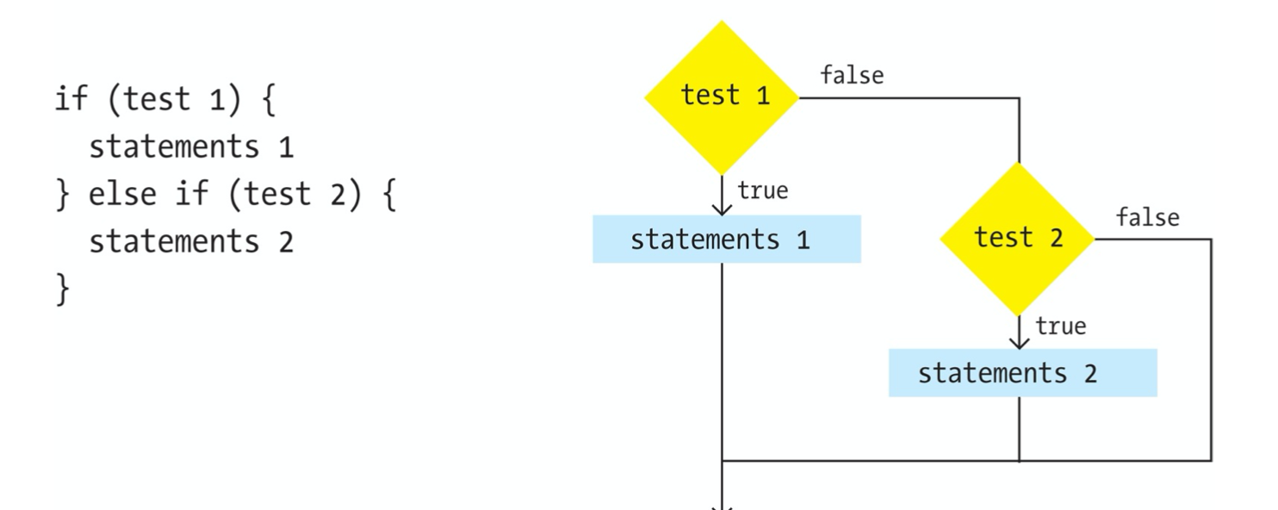
If Else Statement Diagram

Slide 32
Loops (Iteration)

Slide 33
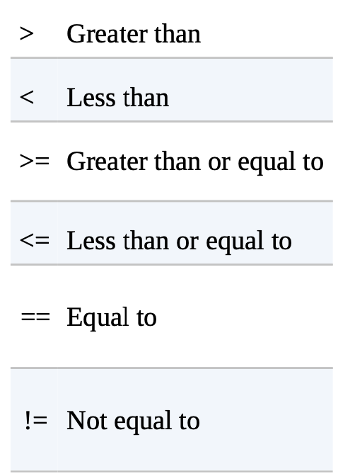
What is a Loop?
As you write more programs, you’ll notice that patterns occur when lines of code are repeated, but with slight variations.
A code structure called a loop makes it possible to run a line of code more than once to condense this type of repetition into fewer lines.
This makes your programs more modular and easier to change.
There are two types of loops: For and While

Slide 34
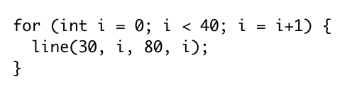
For Loop
init
test
update
A basic for structure has three parts: init, test, and update. Each part must be separated by a semicolon (;). The loop continues until the test evaluates to false. When a for structure is executed, the following sequence of events occurs:
The init statement is run.
The test is evaluated to be true or false.
If the test is true, jump to step 4. If the test is false, jump to step 6.
Run the statements within the block.
Run the update statement and jump to step 2.
Exit the loop
In the example above, the for structure is executed 40 times. In the init statement, the value i is created and set to zero. i is less than 40, so the test evaluates as true. At the end of each loop, i is incremented by one. On the 41st execution, the test is evaluated as false, because i is then equal to 40, so i < 40 is no longer true. Thus, the loop exits.

Slide 35
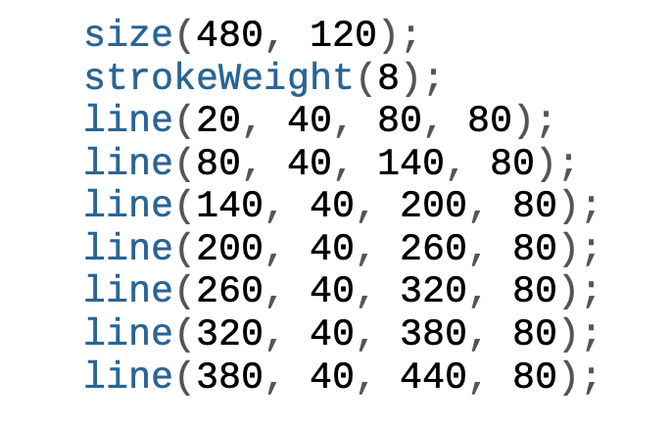
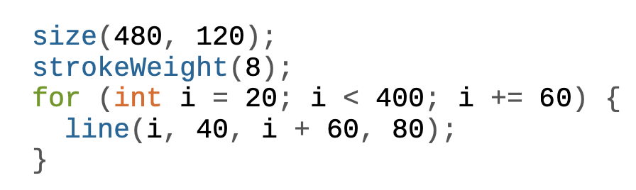
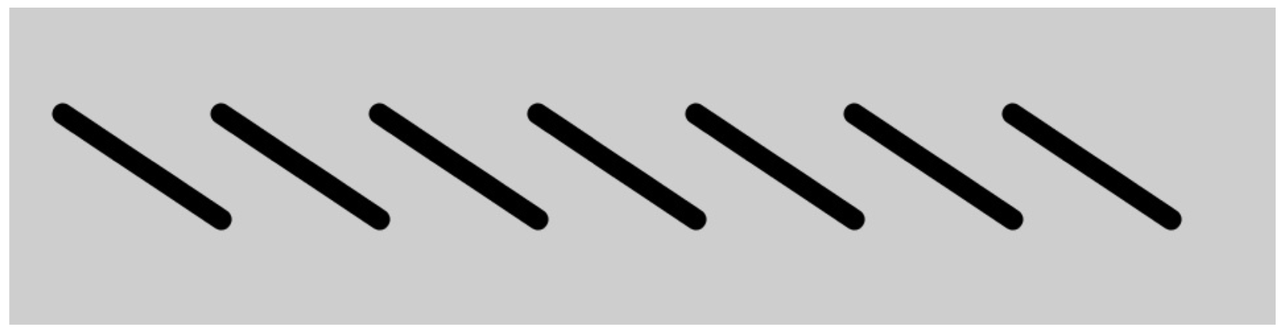
Example of For Loop
Example with no loop
Example with For Loop
Both codes produce the same output but the example with the loop is less tedious to write

Slide 36
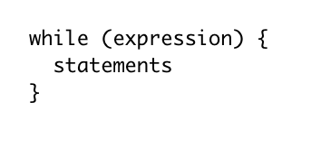
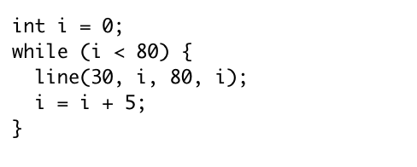
While Loop
As long as this is true
The while structure executes a series of statements continuously while the expression is true.
The expression must be updated during the repetitions or the program will never "break out" of while.
This code is executed
As long as the variable i is less than 80, the line is drawn
the variable is incremented by 5 each time a line is drawn until eventually i becomes 80 and the statement becomes false

Slide 37
Images

Slide 38
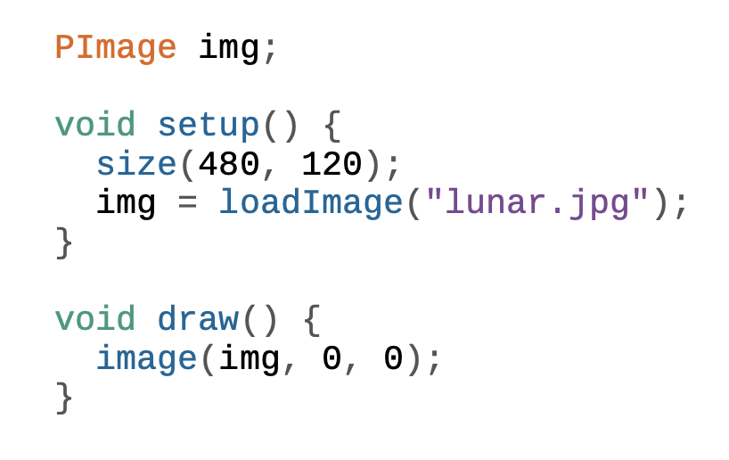
How to Add an Image
There are three steps to follow before you can draw an image to the screen:
1. Add the image to the the same folder as your code.
2. Create a PImage variable to store the image.
3. Load the image into the variable with loadImage().
4. After all three steps are done, you can draw the image to the screen with the image() function.
The first parameter to image() specifies the image to draw; the second and third set the x and y coordinates.

Slide 39
Arrays

Slide 40
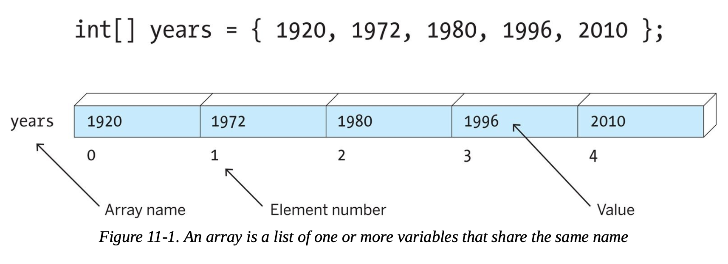
What is an Array?
Each item in an array is called an element, and each has an index value to mark its position within the array.
Imagine what would happen if you wanted to have 3,000 circles. This would mean creating 3,000 individual variables, then updating each one separately. Could you keep track of that many variables? Would you want to? Instead, we use an array.
An array is a list of variables that share a common name. Arrays are useful because they make it possible to work with more variables without creating a new name for each. This makes the code shorter, easier to read, and more convenient to update.
Just like coordinates on the screen, index values for an array start counting from 0. For instance, the first element in the array has the index value 0, the second element in the array has the index value 1, and so on. If there are 20 values in the array, the index value of the last element is 19.

Slide 41
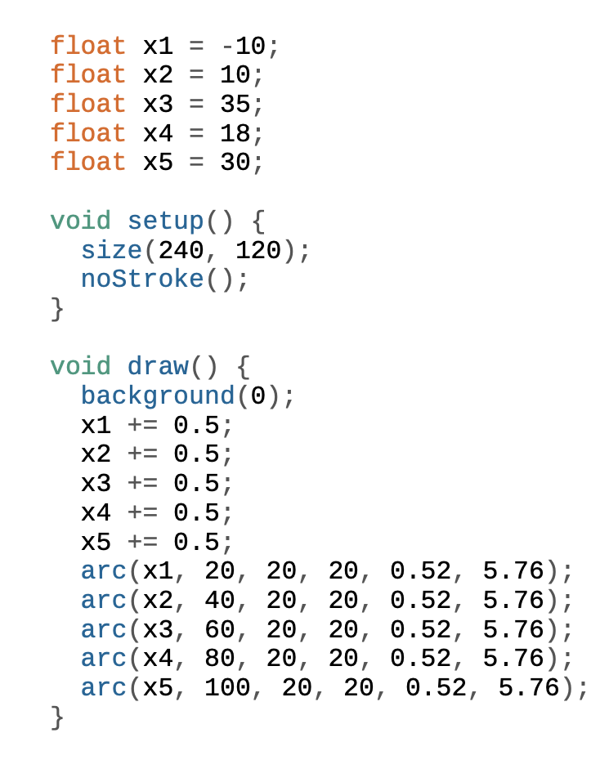
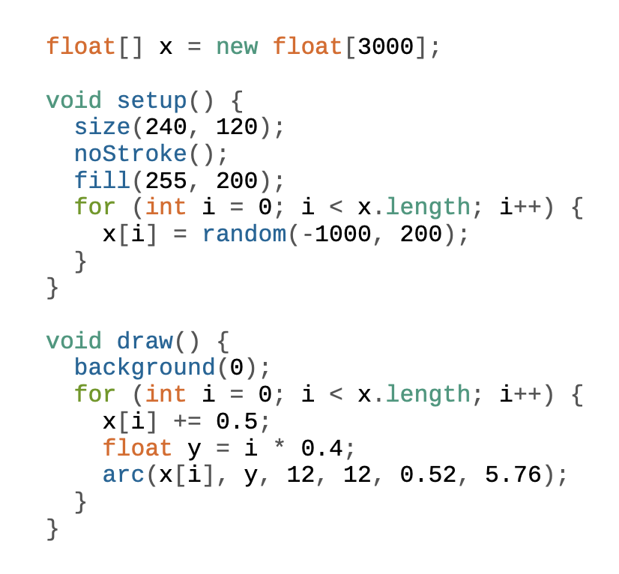
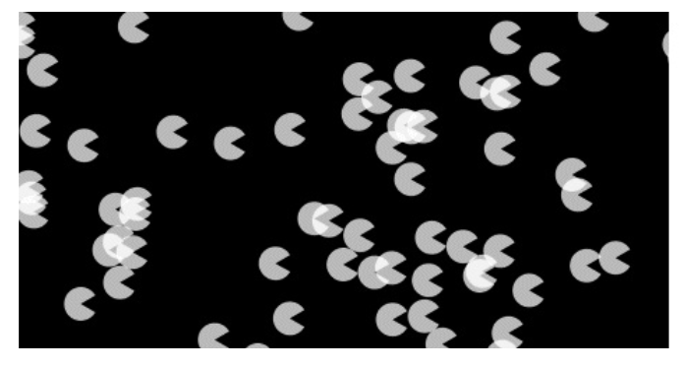
Example of an Array
With Array
Without an array. There are too many variables and the code is out of control.

Slide 42
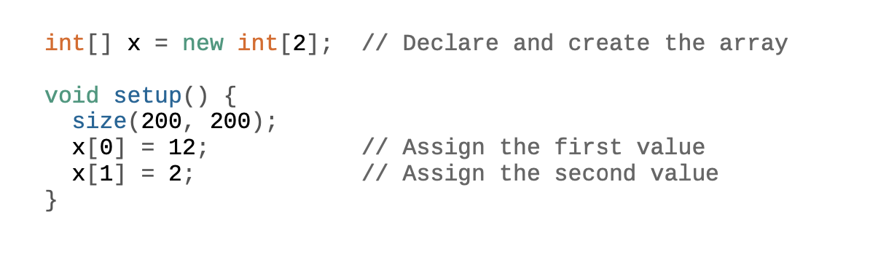
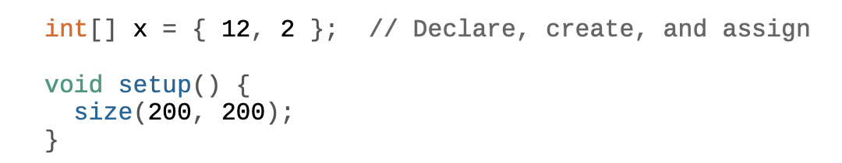
Creating an Array
Example 2. You can also assign values to the array when it’s created, if it’s all part of a single statement:
Example 1. First, we’ll declare the array outside of setup() and then create and assign the values within. The syntax x[0] refers to the first element in the array and x[1] is the second:

Slide 43
The End

Slide 44
Video Explanations
Functions https://www.youtube.com/watch?v=zBo2D3Myo6Q&list=PLRqwX-V7Uu6ajGB2OI3hl5DZsD1Fw1WzR&index=2
Variables https://www.youtube.com/watch?v=B-ycSR3ntik&list=PLRqwX-V7Uu6aFNOgoIMSbSYOkKNTo89uf
Conditional Statements (If Else) https://www.youtube.com/watch?v=mVq7Ms01RjA&list=PLRqwX-V7Uu6YqykuLs00261JCqnL_NNZ_&index=2
Loops (Iteration) https://www.youtube.com/watch?v=h4ApLHe8tbk&list=PLRqwX-V7Uu6bm-3M4Wntd4yYZGKwiKfrQ&index=3
Arrays https://www.youtube.com/watch?v=NptnmWvkbTw&list=PLRqwX-V7Uu6bO9RKxHObluh-aPgrrvb4a&t=163s

